Slide 1
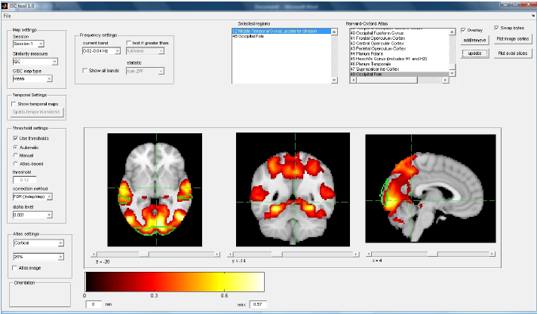
Matlab Toolbox for Inter-Subject Correlation Analysis
Overview

Slide 2
ISC toolbox: Background
fMRI studies utilizing natural stimuli such as movies, music, and video games are getting more and more popular (see, for example [1])
Because these stimuli are extremely complex, modeling hemodynamic responses using the GLM becomes inconvenient
Inter-subject correlation (ISC) analysis does not require modeling of the hemodynamic response and has been succesfully applied to investigate natural stimulus fMRI data sets [2-4]
Comprehensive and easy-to-use toolbox to study the brain based on ISCs would be beneficial

Slide 3
ISC toolbox: Overview
Runs on Matlab
Reads in preprocessed and registered fMRI data either in mat- or nifti-format
The best way to avoid compatibility problems is to preprocess and register your data with the FSL
Graphical User Interface (GUI) developed for:
-setting-up your analysis parameters correctly
-easy and quick visualization of the results
Access of the results is fast and easy also directly using command line options
The use of Matlab’s memory mapping feature avoids many problems associated with large data sets (in terms of both memory and speed)

Slide 4
ISC toolbox: Features
Voxel-wise ISC analysis across n subjects:
-calculation of voxel-wise n by n correlation matrices
- permutation based inference on the average of the n(n-1)/2 subject-pairwise correlation coefficients for each voxel [3]
The above analysis can be performed:
-across the whole scanning session
-within the specified time-windows to obtain time-varying ISC maps
-within distinct frequency-subbands to obtain frequency-specific ISC maps [3]

Slide 5
ISC toolbox: More features
In addition to mean ISC maps, one can investigate other maps including:
-the corresponding median, lower quartile, upper quartile and standard deviation maps
-t statistical maps [4]
-contrast maps to compare ISC between frequency bands [3]
More features will be added to the toolbox in the near future

Slide 6
ISC toolbox: Requirements
The maximum amount of memory required to run group ISC analysis is determined by the size of the fMRI data of a SINGLE subject (consider also memory limitation of Matlab)
To run analysis in feasible time, we highly recommend grid computation unless very powerful computer is available.
After running the analysis, quick visualization and command line access of the results should be possible using your personal laptop.

Slide 7
ISC toolbox: Availability
Free toolbox is available via the following link:
http://sites.google.com/site/frequencyspecificisc
For any questions, contact:
Jukka-pekka.kauppi {at} tut.fi

Slide 8
References
[1] H. Spiers and E. Maguire, "Decoding human brain activity during real-world experiences," Trends in Cognitive Sciences, vol. 11, no. 8, pp. 356-365, August 2007.
[2] Hasson et al: “Intersubject synchronization of cortical activity during natural vision,” Science, vol. 303, no. 5664, pp. 1634–1640, March 2004.
[3] Kauppi et al: ”Inter-subject correlation of brain hemodynamic responses during watching a movie: localization in space and frequency," Frontiers in Neuroinformatics, March 2010.
[4] Wilson et al: “Beyond superior temporal cortex: Intersubject correlations in narrative speech comprehension,” Cereb. Cortex, vol. 18, no. 1, pp. 230–242, January 2008.

